Slide 1




NORTH-POINT SOFTWARE
LISTING COMPANY
SELECTING SUCCESS
PROFITABLE CUSTOMER SELECTION
DRIVEN BY DATA ANALYTICS

Slide 2
AGENDA
The Experiment
Goals
Predictive Modeling
Recommendations
Moving Forward

Slide 3







THE EXPERIMENT
20,000 random customers were selected from the pool of 5M, resulting in 5.3% purchaser response rate & average spending of $102.62 per purchaser.
Extrapolating these results to the remaining 180,000 customers suggests a gross profit of $619,037.7 (after subtracting mailing expenses of $2 per mail).
5 M
random
experiment
random
180,000
20,000
average calculation
$102.62
extrapolating on remaining 180,000
$61﻿9,037.7

Slide 4


GOALS
Identify by rank top 180,000 potential purchasers from the shared pool.
Maximize sales &profits by targeting high-potential customers.
Mitigate randomness in customer selection through predictive algorithms.
Classifier modelling
Regression modeling
5 M
180,000

Slide 5
CLASSIFICATION
Logistic Regression is the optimal choice for ranking customers, as it uses probabilities to classify customers.
Achieved a 74.29% accuracy rate & 97.99% sensitivity.
Cumulative gain chart demonstrates the model's superiority over the baseline, with a 50% correct classification rate for purchasers compared to the baseline's 25% at the 25% sample mark.

Slide 6
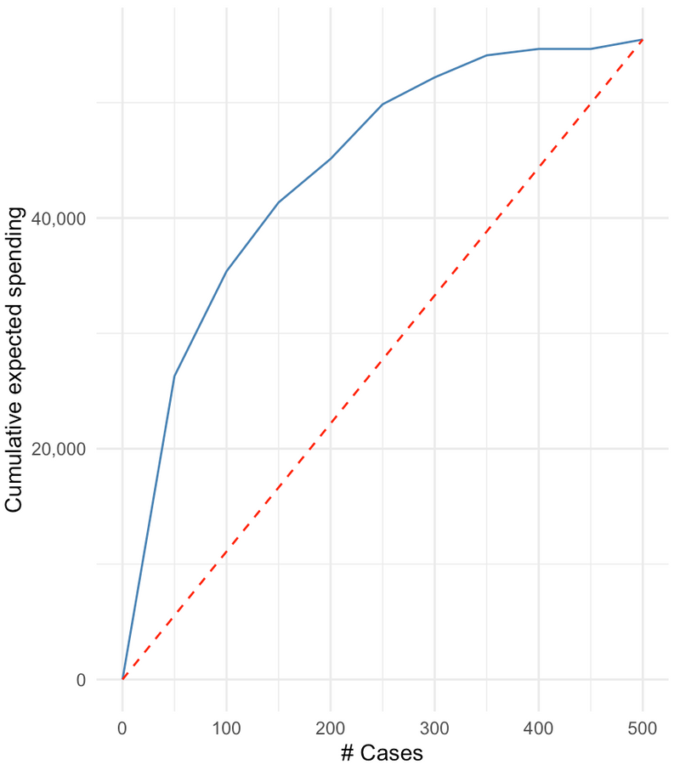
REGRESSION
Multiple Linear Regression is the optimal choice for estimating sales & profits for purchasers.
MAE = 71.69 on average, the model's predictions
deviate from observed spending by ~ $71.69.
Cumulative gain chart illustrates the model's superiority, outperforming the baseline by fourfold.

Slide 7


RECOMMENDATION
Naive Baseline
Model
Predictive
Analytics
$61﻿9,037.7
$1,630,902

Slide 8
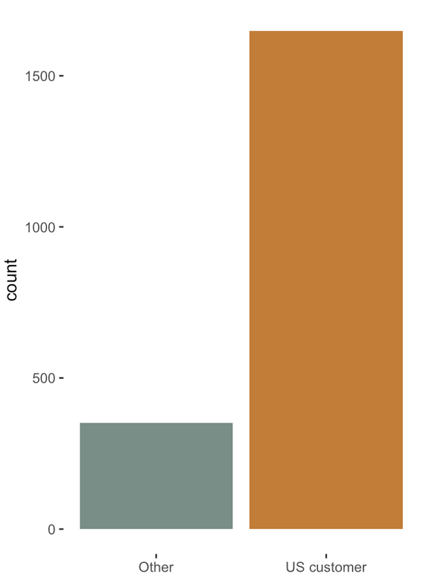

MOVING FORWARD
Customer base expansion to other countries.
Product recommendations using associative
rules.

Slide 9
NORTH-POINT SOFTWARE
LISTING COMPANY
THANK YOU
Lavanya Govindarajan

